Slide 1
AI Learning

Slide 2
AGENDA
1. AI introduction
2. Communicate with AI model & Demo
3. RAG (Retrieval Augmented Generation) & Demo

Slide 3
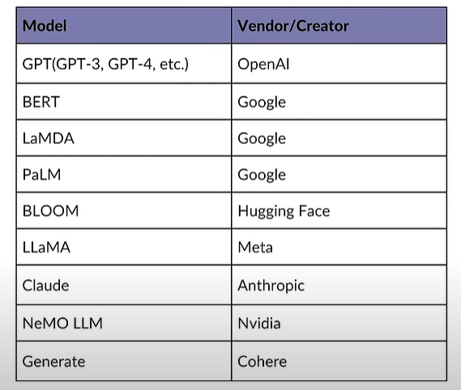
AI InTRODUCTION

Slide 4
What is AI?
Artificial Intelligence (AI) involves creating systems that perform tasks requiring human intelligence, using techniques like machine learning and deep learning. Developers use to build, train, and deploy AI models for applications in natural language processing, computer vision, and more….
AI Model = Data + architecture(ex: ChatGPT) + Training (continuously)
How to communicate with AI model ?
Use CLI/Terminal or API and send prompts then receive response
Prompt example: (https://platform.openai.com/docs/examples)
Prompt: What is the capital of Viet Nam?
Response: The capital of Viet Nam is Ha Noi

Slide 5
Prompt:
Prompts are crucial for interacting with AI models, as they determine the quality and relevance of the generated
Tips for Effective Prompts
Be Clear and Specific: Provide clear and specific instructions to guide the AI towards the desired output.
Use Examples: Including examples in the prompt can help the AI understand the expected format and style. (Few-shot Learning)
Adjust Length and Detail: Depending on the complexity of the task, adjust the length and detail of the prompt to ensure the AI has enough information to generate a relevant response.
Iterate and Refine: If the output is not as expected, iteratively refine the prompt to better guide the AI.

Slide 6
RAG (Retrieval Augmented generation)

Slide 7
What is RAG ? (https://www.youtube.com/watch?v=u47GtXwePms)
Retrieve external documents that relate to questions and feed them with prompt and then send to AI Model (Large Language Model).
LangChain (https://js.langchain.com/v0.2/docs/introduction/)
Opensource framework that allows AI developers to combine LLMs like GPT-4 with external sources of computation and data. It is released with Python and JS packages.
It has specific workflows that can help to create:
Chatbots
Summarization
Question answering
Virtual Agent

Slide 8
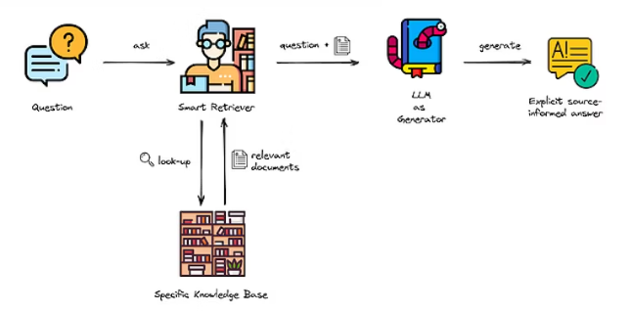

Slide 9
Q&A SeSSION

Slide 10
THANK YOU
Long Tran
206-468-1067
longthb3112@gmail.com

